Slide 1

Guiding you towards
CX and EX excellence

Slide 2
Is everything
to your satisfaction?
Ask your customers and employees this question and you hope they will answer a resounding "yes." After all, that would mean that your organization is producing good results and that the people you depend on are satisfied. But is that "yes" truly sincere? What exactly does it imply then? And what if the answer is "no"?
Answers to questions like these are essential to the health and growth of your business. But you cannot get them on your own.
Research into customer and employee experience will provide this valuable information which allow you to strengthen and improve your position. This is not just about data, but about insights that make a difference for your organization.
Because only when your research leads to valuable insights, will those insights lead to improvements that generate a decisive impact.
It is no coincidence that from insight to impact is the baseline for excap, the market research company that has made the difference with their research for dozens of organizations in over 20 countries.
From insight
to impact
Interested?
Meet excap.

Slide 3
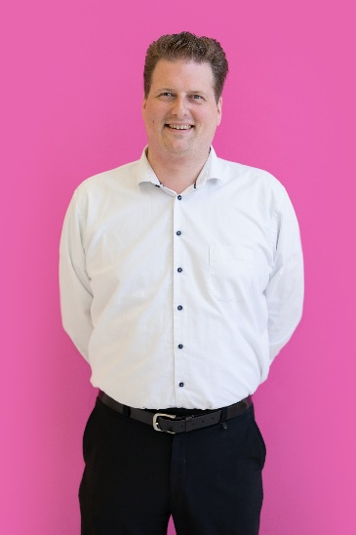



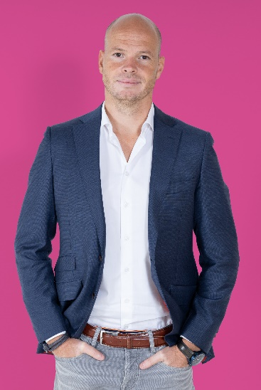


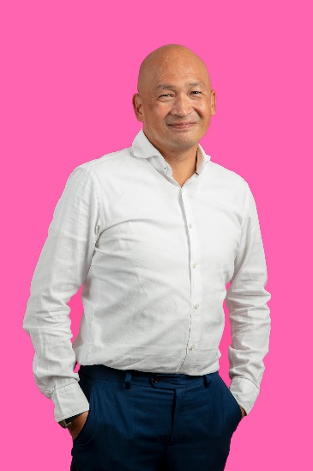
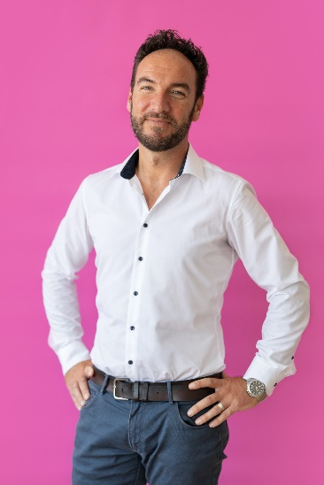
We are excap
Our vision
Excap has been improving the experience of customers and employees for companies like yours for more than 17 years.
What started out as a graduation project, soon grew into a leading research agency with a well-stocked trophy case, an NPS score of no less than 73 and a team that shows on a daily basis what a company can achieve that acknowledges the true value of excellent employee experience.
This team is united by excap’s three core values: top quality, innovation and enthusiasm
Thanks to these values, excap managed to become and remain market leader in the BeNeLux. Happy customers throughout Europe ensued.
Our commitment to top quality, innovation and enthusiasm challenge us every day to help boost your growth in CX and EX.
Whether you are in need of a change process, data analysis, coaching or complex mystery guest research, you can count on us from start to finish.
Top quality, innovation and enthusiasm. Every day!

Slide 4
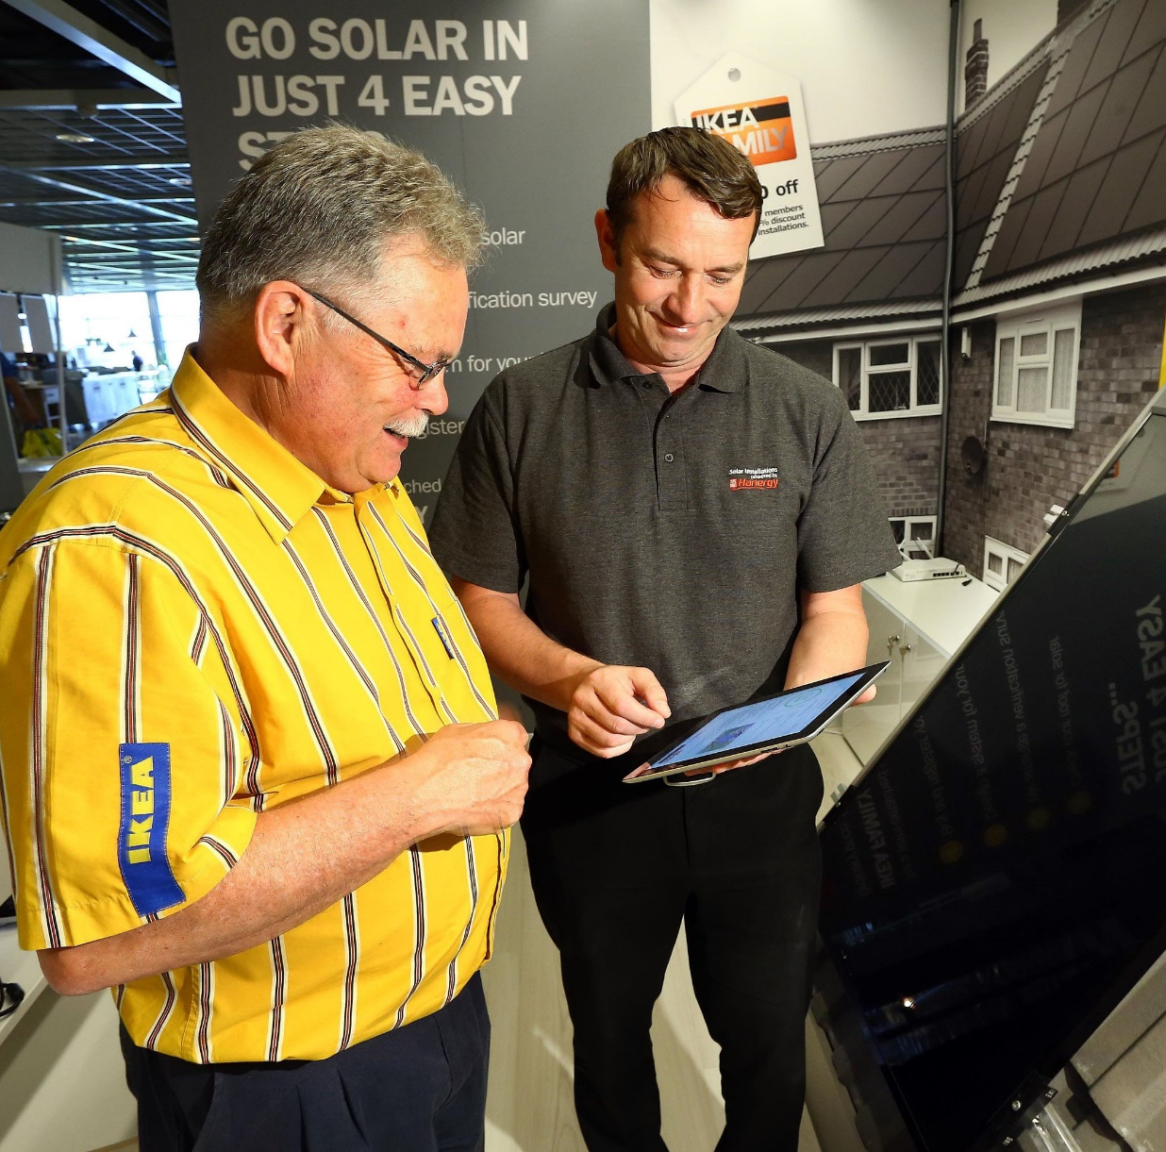
grow
How we help you
Mystery shopping research
Your customers' experience of their jour- ney depends on many factors. The moment of truth can lurk in an unexpected corner. Our mystery shoppers reveal it to you.
Mystery calling
Mystery calling research will gain you insights in the experience of your customers when speaking to your employees.
Online mystery shopping research
Online mystery shopping exposes bott- lenecks in your website or webshop, so you can improve the online user experience of your customers.
Employee experience
Examine the attitude and behavior of your employees and their underlying motives by using excap’s scientific EX research method.
Feedback mystery shopping
In this form of mystery shopping rese- arch, our mystery shoppers make themselves known directly to your employee, offering live feedback about the way they have been helped after their visit.
Audits
Measure the core of your retail/dealer/ shop location by using hard data and gain direct insights on pos materials, brand compliance, pricing and stock levels.
Qualitative and quantitative research
Take action and analyze your organization with our in-depth interviews, panels, customer arenas, focus groups, master- classes and after sales research studies.
Coaching & consulting
Excap offers workshops, coaching, insights discovery® and change management to provide your employees with all the necessary knowledge in the field of customer experience and employee experience.
“Excap's greatest asset is their customer-oriented approach. I was very satisfied, also about the tools such as the dashboard and the management reports with tips and ideas.”
Wouter Fonteyne
Commercial Leader
Solar & Energy Services - Ikea

Slide 5

Why
you choose us
Market leader in mystery guest research and audits in the Benelux. We have been the partner of choice for dozens of customers for years.
Demonstrable experience at your fingertips thanks to real Customer Journey experts who know how to avoid every pitfall and deliver projects successfully and beyond expectations.
We visualize your current and desired situation, creating insight into your most important frictions, gaps and moments of truth.
A method that works from a customer perspec- tive instead of organized processes. It offers you the possibility to integrate (existing) personas.
Market leader in mystery guest research and audits in the Benelux. We have been the partner of choice for dozens of customers for years.
Demonstrable experience at your fingertips thanks to real Customer Journey experts who know how to avoid every pitfall and deliver projects successfully and beyond expectations.
We visualize your current and desired situation, creating insight into your most important frictions, gaps and moments of truth.
A method that works from a customer perspec- tive instead of organized processes. It offers you the possibility to integrate (existing) personas.
We do more than just carry out an assignment. We provide you with solicited and unsolicited suggestions and advice, helping you achieve lasting improvement.
Our user-friendly platform showcases our passion for innovation. User hierarchy, extensive export options and 24/7 access are just some of the many features you and your team will love.
An NPS score of no less than 73 shows our customers are very satisfied with our way of working and quality.
We do more than just carry out an assignment. We provide you with solicited and unsolicited suggestions and advice, helping you achieve lasting improvement.
Our user-friendly platform showcases our passion for innovation. User hierarchy, extensive export options and 24/7 access are just some of the many features you and your team will love.
An NPS score of no less than 73 shows our customers are very satisfied with our way of working and quality.

Slide 6











Quality
mysteryshoppers
Selection
Feedback
New mystery shoppers are required to pass our screening test to meet our quality standards.
Each mystery shopper receive personal feedback on every report, encouraging them to continuously improve their work for you.
Delivering top quality starts with the right approach by the right people. Excap’s mystery shoppers are at the base of your impact, thanks to their strict adherence to our refined procedures.
We will develop a case to thoroughly prepare the shoppers for visiting your company.
Our quality controllers ensure a continuous link between execution and analysis of the data.
Quality
checks
Cases
We map out the functional and emotional experience, and answer the why question behind it to get you started right away.
An extensive briefing precedes each assignment, making sure each detail of the assignment is crystal clear.
Questionnaire
Briefing
Target group selection
Excap makes a careful selection for each research and uses only mystery guests who match the profile of your target group.

Slide 7
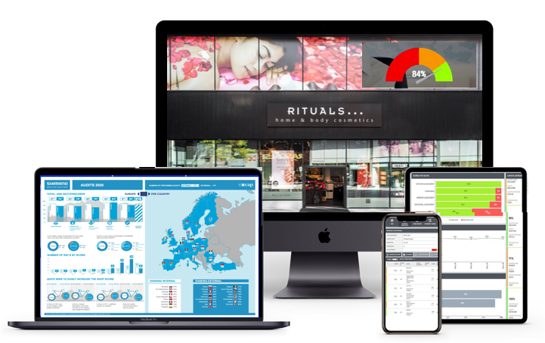


The reports you need
Optional
Insights Management Report
Analyzes and conclusions
Advice, recommendations and actionable improvements
Ranking of dealers
Strategic and at dealer level
Visual and narrative
Quotes of mystery shoppers
Comparison between different periods (waves)
Online dashboard
Optional
Infographic/Presentation/Scorecards (not quoted)
24/7 available
Laptop, mobile and tablet
Quick analyzes
Scores on total and at dealer level
PDF report per dealer
English and local language
Presentation of research results
Visual and narrative
Infographics available on country level + HQ level or per dealer
Scorecards possible

Slide 8



International focus & coverage
Whether you’re looking into research for just one country or the whole of Europe and beyond,
Headoffice International Antwerp Belgium
no project is too
small or too big.
We aim to be your global partner, providing you with insights that will actually generate impact and answer those questions which make a difference. Like we currently do in over 20 countries.

Slide 9









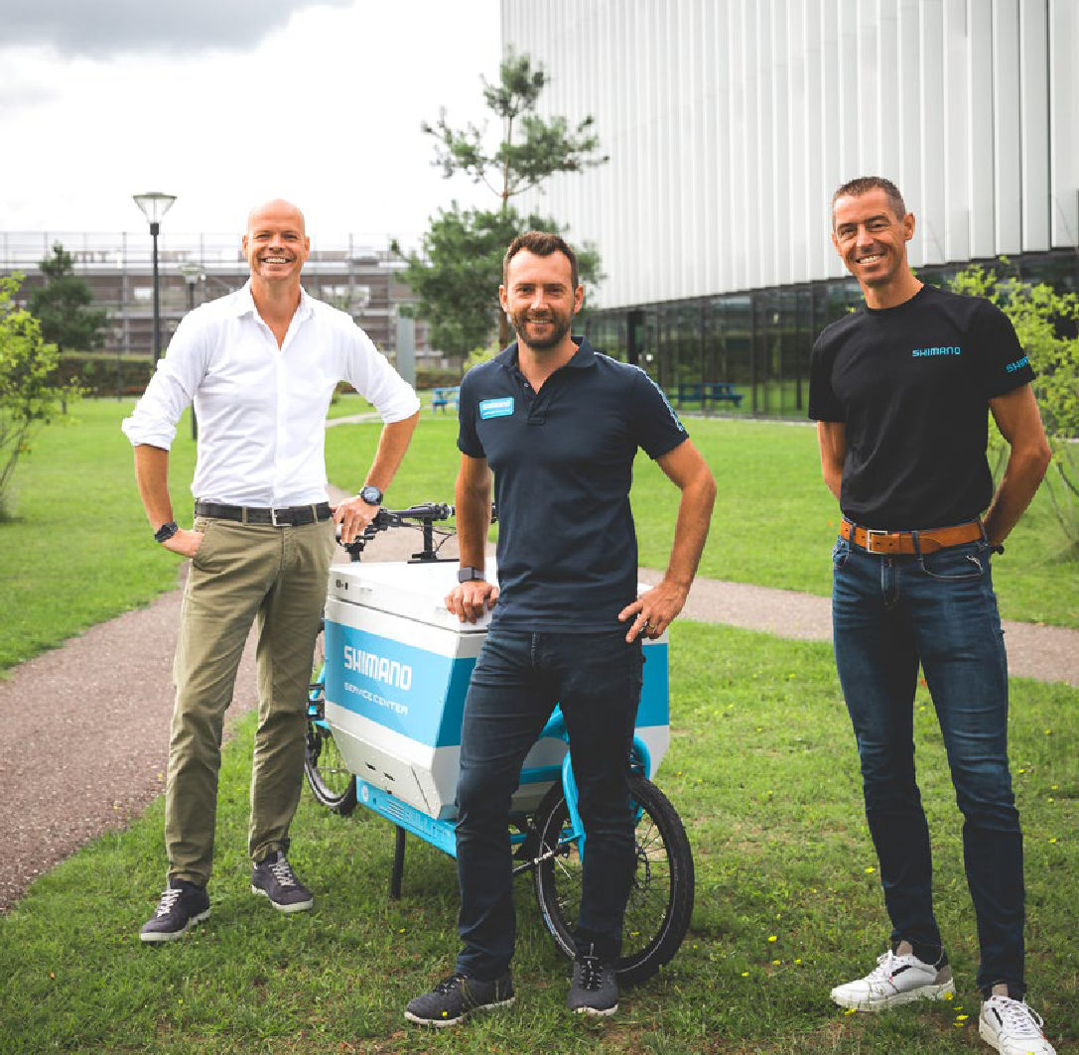


Our trusted partners
Cool cases
These are just some of the partners that have preceded you in optimizing their customer experience.
Shimano
got their customers involved
Scotch & Soda
turned every store visit
into an experience
IKEA solar panels
Shedding light on the
buyer journey

Slide 10

Curious?
Get in touch.
Renik will be glad to answer any questions you may have.
renik@excapinternational.com

